Slide 1

Welcome To

Slide 2
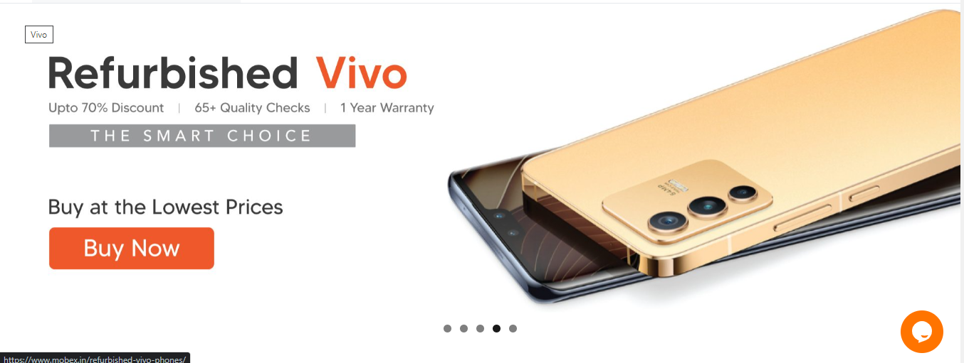
Projects - Work Done
Mobex website
Make a new Slider home page And 5 banner images add
All website are mobile friendly as requirement .

Slide 3
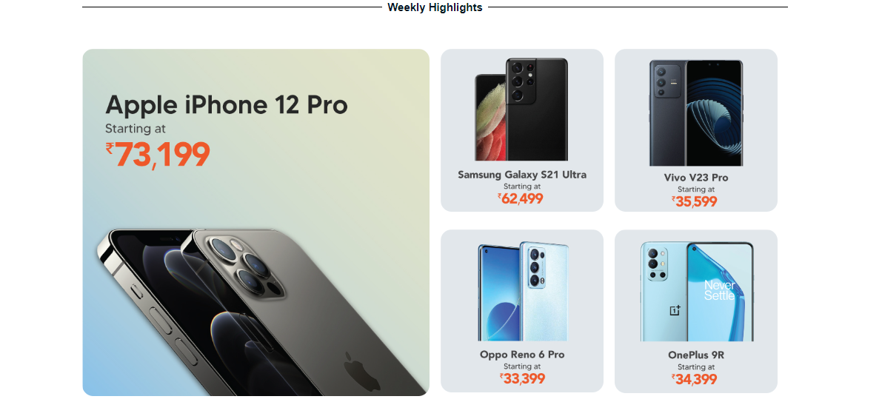
Projects - Work Done
Add new section Weekly Highlights home page highlight 30k rang mobile.
All website are mobile friendly as requirement .

Slide 4
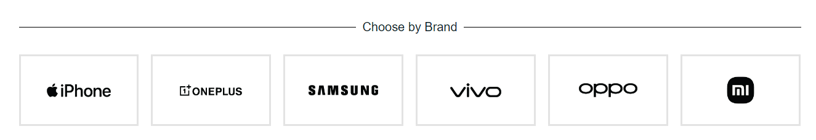
Projects - Work Done
Choose by Brand section created new design add home page
All website are mobile friendly as requirement .

Slide 5
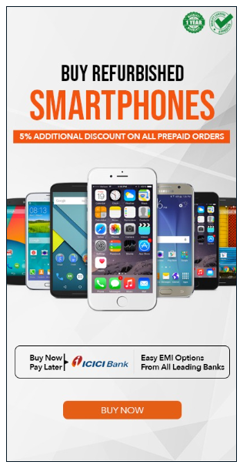
Projects - Work Done
Add in left side banner buy refurbished banner redirect was shop page
All website are mobile friendly as requirement .

Slide 6
Projects - Work Done
Mobex website
convert and add new images in all image in choose your brand in section jpg to webp.
convert and add new images in image in featured in section jpg to webp.
added in home page Stock clearance section
When Login or Register password click show check box button password was show
all product created and created in new category
page are created by stock clearance
3 Banner Home Page New added
3 Small banner Home page New added
Implement by the Light deals show only 40% discount product
Link change for page 7 day /65+ quality/1 year/no Contact delivered
All website are mobile friendly as requirement .

Slide 7
Projects - Work Done
Website Changes
Stock Shop page Images in change
Add in new page Refurbished iPhone
Add in new page Refurbished iPhone banner
Add in new page Refurbished iPhone offer was added
Add in new page Refurbished OnePlus Phones
Add in new page Refurbished OnePlus Phones banner
Add in new page Refurbished OnePlus Phones offer was added
Tawk.to change the position in both of device(Mobile and desktop)
All website whole back up
Created by the Product Listing mobex.in API in live
Resolved in Pop API issue
Order Status defined role per user
Privacy Policy change in content
email issue resolved mobex.in website
All website are mobile friendly as requirement .

Slide 8
Projects - Work Done
Website Changes
Add in new page Refurbished Samsung Phones
Add in new page Refurbished Samsung Phones banner
Add in new page Refurbished Samsung Phones offer was added
Add in new page Refurbished Oppo Phones
Add in new page Refurbished Oppo Phones banner
Add in new page Refurbished Oppo Phones offer was added
Add in new page Refurbished Vivo Phones
Add in new page Refurbished Vivo Phones banner
Add in new page Refurbished Vivo Phones offer was added
Add in new page Refurbished Xiaomi Phones
All website are mobile friendly as requirement .

Slide 9
Projects - Work Done
Website Changes
Add in new page Refurbished Xiaomi Phones banner
Add in new page Refurbished Xiaomi Phones offer was added
Order tracking page change the name billing email to email id
Change the brand image in choose by brand section
Change the Featured all image in featured in section
Implemented brand wise and RAM wise show
Related product.
FAQ banner add in FAQs page

Slide 10
Projects - Working
Mobex.in Working
Multi Store (Location wise stock Updated)
AMP (Accelerated Mobile Pages)
PWA (Progressive web application)
Stick Buy now and add to cart
Variant Different set in All product design end
Simpl Pay In -3 (Payment getway)
Blue dart
Sell your phone page Design and functionality
add to Offer addon product wise
Career Page Create in Mobex site
add to addon product wise
All page banner changes

Slide 11
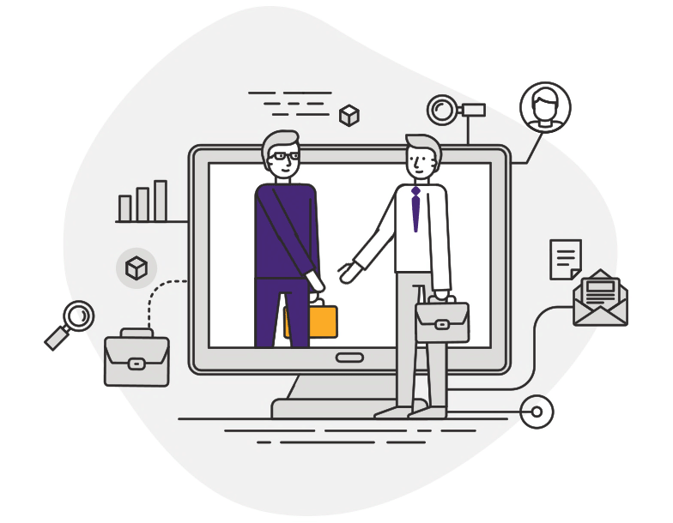
Thank You

